Slide 1
Adrenal Gland
Dr.Deepa.G.S
Associate Professor
Dept of Physiology
SKHMC

Slide 2
Adrenal Glands
Two adrenal glands-Life saving glands
Situation-Upper pole of each kidney
Weight-4-5g
Consists of two parts
Outer cortex—80% of the gland
Inner medulla-20% of the gland

Slide 3
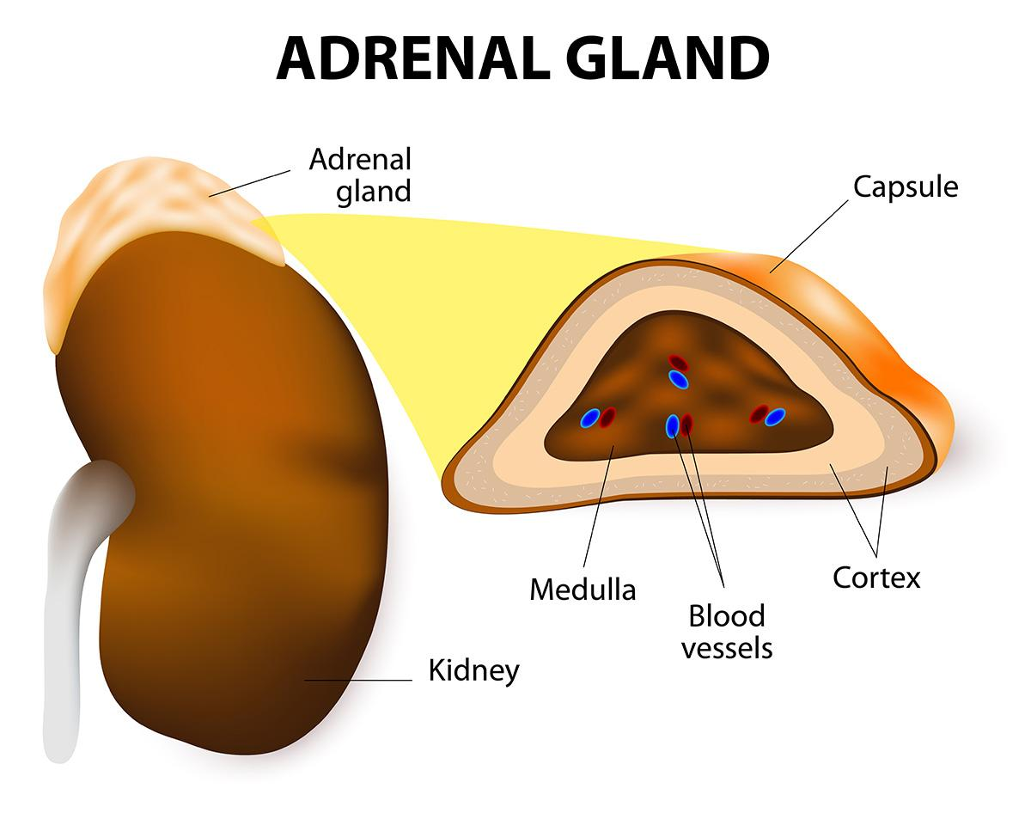
https://www.hopkinsmedicine.org/health/conditions-and-diseases/adrenal-glands

Slide 4
Adrenal cortex-Histology
Zona glomerulosa-15%,outer zone
Zona Fasciculata-50% of total mass, widest zone
Zona Reticularis-innermost layer,7%

Slide 5
Adrenal cortex-Hormones
Corticosteroids-3 groups
1.Mineralocorticoids- by Z.Glomerulosa
Aldosterone,11-Hydroxycorticosterone
2. Glucocorticoids- Z.fasciculata
Cortisol, Corticosterone , cortisone

Slide 6
Adrenal cortex-Hormones
Sex steroids
Estrogen, progesterone
Androgens

Slide 7
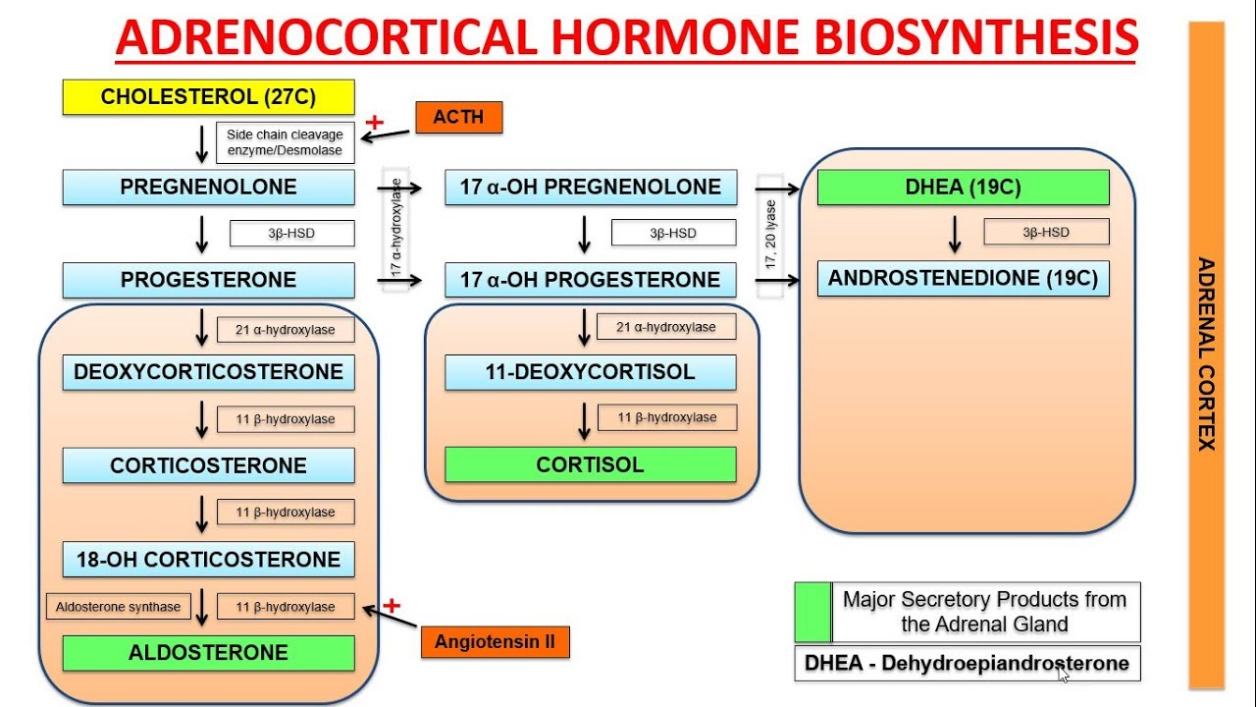
Synthesis of cortical hormones
https://www.youtube.com/watch?v=431tLBZ7d1o

Slide 8
Glucocorticoids
Life Protecting hormone
Source- Z.Fasciculata
Transport: Mainly by cotisol binding globulin

Slide 9
https://www.slideshare.net/shashikant246/mechanism-of-steroid-hormone-action

Slide 10
Glucocorticoids : Functions
Cortisol is more potent-95% glucocorticoid activity
Carbohydrate metabolism-Anti insulin action
Decreases peripheral utilization of glucose except in brain and heart.
Stimulates gluconeogenesis-from aminoacids
Glycogen synthesis and deposition
Hypersecretion-Adrenal diabetes

Slide 11
Glucocorticoids:Functions
Proteins metabolism-promotes catabolism of proteins
Mobilization of protein from tissues(Increase plasma amino acids) other than liver
Increase uptake of amino acids by hepatic cells helps in Gluconeogenesis
Hyper secretion –Negative nitrogen balance

Slide 12
Glucocorticoids:Functions
Fat metabolism:
Mobilization of fat from adipose tissue
Increase availability of fatty acids for utilization-Formation of ketone bodies
Lipogenesis
In excess it redistributes fat-Deposition of more fat in trunks at the expense of extremities-moon face, buffalo hump etc

Slide 13
Glucocorticoids:Functions
Water and electrolyte metabolism
Accelerates excretion of water
Retention of sodium
Excretion of K
Decrease absorption of calcium from intestine
Hypersecretion: Oedema, hypertension, Hypokalemia, muscular weakness

Slide 14
Glucocorticoids:Functions
On Bone:
Osteoclastic activity-Bone resorption
Inhibit osteoblastic activity
Hypersecretion: Osteoporosis
On Muscles:
Catabolism of proteins
Hypersecretion: weakness,muscle wasting, Thinning of skin

Slide 15
Glucocorticoids:Functions
On Blood and immune system
Decreases eosinophils, basophils, lymphocytes,
monocytes
Increases-Platelets,neutrophils,RBC
In therapeutic dose: Anti inflammatory,
Anti allergic, Immunosuppressive

Slide 16
Glucocorticoids:Functions
Permissive action of glucocorticoids
Normal level of glucocorticoids secretion is necessary for number of metabolic reactions exerted by other hormones
This includes
Gluconeogenesis action of glucagon
Vasodialator effects of catecholamines
Calorigenic effects of catecholamines
Fattyacid mobilizing effect of catecholamines

Slide 17
Glucocorticoids:Functions
On CVS
Essential for the constrictor action of adrenaline and nor-adrenaline
Hyposecretion-Vascular collapse
Increase force of myocardial contarction
Increase secretion of angiotensin

Slide 18
Glucocorticoids:Functions
On Respiratory system
Necessary for maturation of fetal lung by stimulating the secretion of surfactant
On central nervous system
Essential for normal functioning of brain
Influence brain growth and development in neonatal period
Excess: Psychosis
Deficiency-irritability, inability to concentrate, personality changes

Slide 19
Glucocorticoids:Functions
On GIT
Absorption of water and soluble fat
Stimulate gastric acid and pepsin secretion
On resistance to stress
Release of amino acids from tissues to liver cells for synthesis of new proteins and substances to with stand stress
Release of fatty acids for energy production
Enhance vascular response of catecholamines and fatty acid mobilization of catecholamines

Slide 20
Glucocorticoids:Functions
Anti allergic
Prevents antigen antibody formation and thus release of histamine from mast cells
Relieve the symptoms of asthma, hypersensitivity

Slide 21
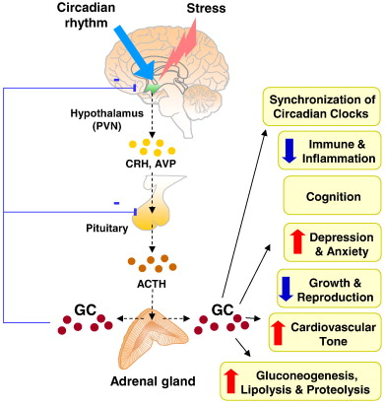
Regulation of secretion
https://www.sciencedirect.com/science/article/pii/S0925443911000329

Slide 22
Hypersecretion of glucocorticoids-Cushing’s syndrome
Causes
Prolonged administration of glucocoticoids
Tumor of adrenal cortex
Tumor of pituitary gland
Increased CRH secretion

Slide 23
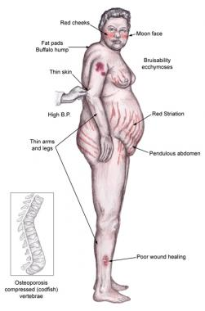
Cushing’s syndrome
https://emedicine.medscape.com/article/2233083-overview

Slide 24
Cushing’s syndrome
Most common presenting symptom-Loss of muscle tone
Adrenal diabetes mellitus-Hyperglycemia
Protein depletion-Muscle wasting, Thinning of skin
Redistribution of fat
Thinning of extremities
Moon face
Buffalo hump
Pot belly
Deposition of fat in abdomen, deficiency of collagen fibers and thinning of skin leads to purplish striae

Slide 25
Cushing’s syndrome
Cholesterol and lipid content in blood increases
K depletion-Hypokalemia
Oedema and Hypertension due to sodium and water retention
Weakening of muscles ,Osteoporosis

Slide 26
Cushing’s syndrome
Immunosuppression
Poor wound healing
Skin pigmentation in ACTH dependant type which has melanocyte stimulating effect
Hirsutism
Acanthosis

Slide 27
Mineralocorticoids
Aldosterone-95% of mineralocorticoid action
11-deoxycorticosterone

Slide 28
Aldosterone-Functions
Life saving hormone
Reabsorption of Na from renal tubules
Excretion of potassium through renal tubules
Secretion of hydrogen into renal tubules
Hypersecretion:hypotension,hyperkalemia
collapse,death

Slide 29
Aldosterone-Functions
Reabsorption of Na from DCT and CD
Increase in ECF volume
Increase in BP
No oedema due to alsosterone escape

Slide 30
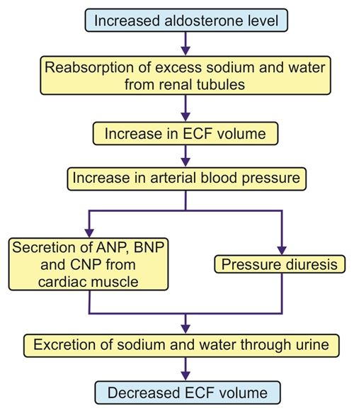
Aldosterone escape
https://www.jaypeedigital.com/book/9789385999468/chapter/ch54

Slide 31
Aldosterone-Functions
Increases potassium excretion
Tubular secretion of hydrogen ions-Acid base balance
Reabsorption of Na from sweat and salivary glands
Reabsorption of Na from intestine

Slide 32
Aldosterone-Functions
Aldosterone excess-Hypokalemia-Muscle weakness
Aldosterone deficiency-Hyperkalemia-Cardiac toxicity-Arrythmia
Increased H ion excretion-metabolic alkalosis

Slide 33
Aldosterone-Mechanism of Action
Same as steroid hormones-DNA dependent mRNA synthesis-Aldosterone induced protein synthesis
Receptors
Type 1 receptors in distal nephron, salivary glands, gut mucosa
Type II receptors have affinity for glucocorticoids

Slide 34
h
t
tps://www.slideshare.net/ArmanMalik24/aldosteron

Slide 35
Aldosterone-Regulation of secretion
Increase in K concentration in ECF
Decrease in Na--Renin angiotensin mechanism
Decrease in ECF
Circadian Rhythm
ACTH-minor role in normal conditions

Slide 36
Hyperaldosteronism
Primary hyperaldosteronism or Conn’s syndrome
Cause-Adenoma
Features
Hypokalemia- failure in concentration capacity of urine-renal damage-Hypokalemic nephropathy
Hypernatremia-No oedema or severe hypertension due to escape effect

Slide 37
Hyperaldosteronism
Due to Hypokalemia
Muscular weakness
Metabolic alkalosis-as more H ions are secreted and increased HCO3 reabsorption
Lowers Ca ions-latent tetany
Glucose tolerance decreases

Slide 38
Addison’s disease-Primary Adreno cortical insufficiency
Cause:
Autoimmune disease
Infections
Cancer of adrenal gland
Congenital unresponsiveness to ACTH
Features: Due to corticosteroids and aldosterone deficiency

Slide 39
Addisonian crisis
Acute form of adrenal cortex insufficiency occurs after
Adrenalectomy
Abrupt withdrawal of therapeutically administered glucocorticoids
Reduced basal secretion of cortisol when exposed to sudden stress or infection
This leads to circulatory collapse and death

Slide 40
Adrenal Medulla
Derived from neural crest
Sympathetic ganglion in which post ganglion cells lost axon and specialized to release their products to blood
Sympathomedullary system-stimuli that activate adrenal medulla also activates sympathetic nervous system
Adrenal hormone activity ten times more than sympathetic stimulation

Slide 41
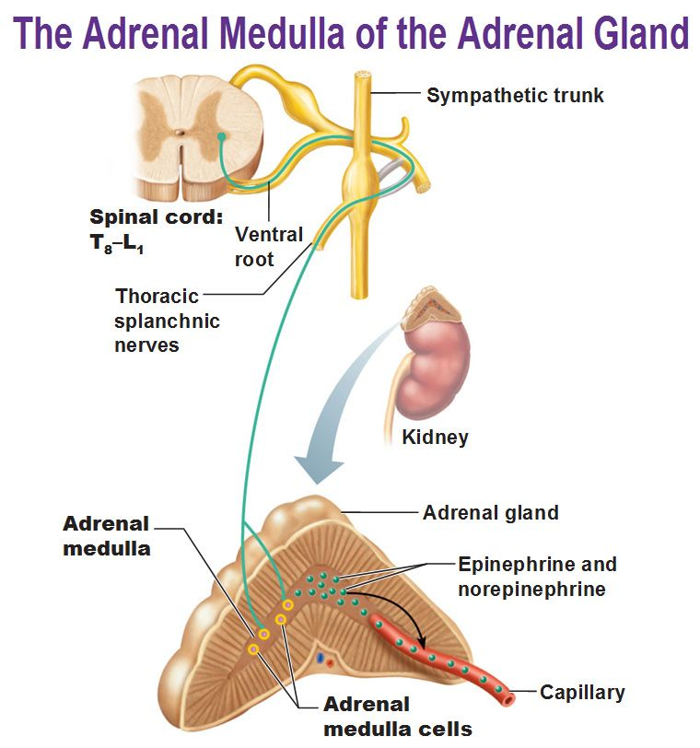
https://in.pinterest.com/pin/349732727305169376/

Slide 42
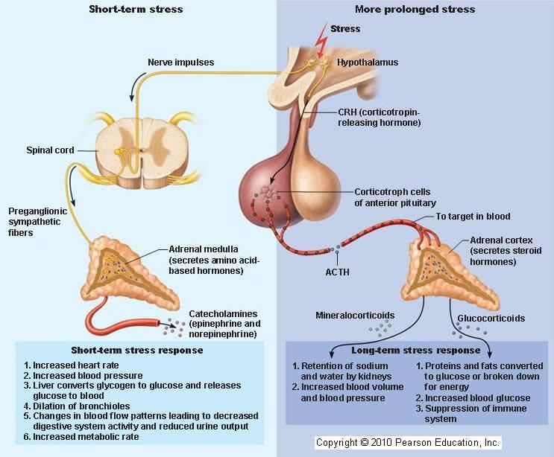

Slide 43
Adrenal medulla
Interlacing cords of granules containing cells- chromaffin cells
Two types
Adrenaline secreting cells-90%
Noradrenaline -secreting cells-10%

Slide 44
Adrenal medulla-Hormones
Epinephrine (Adrenaline)-Predominant
Norepinephrine(Nor adrenaline)
Dopamine

Slide 45
Adrenal medullary hormones-Biosynthesis
From amino acid-Tyrosine or Phenylalanine
Rate limiting enzyme-Tyrosine hydroxylase
Phenylketonuria-deficiency of phenylalanine hydroxylase-mental retardation,decrease muscle tone ,learning and memory

Slide 46
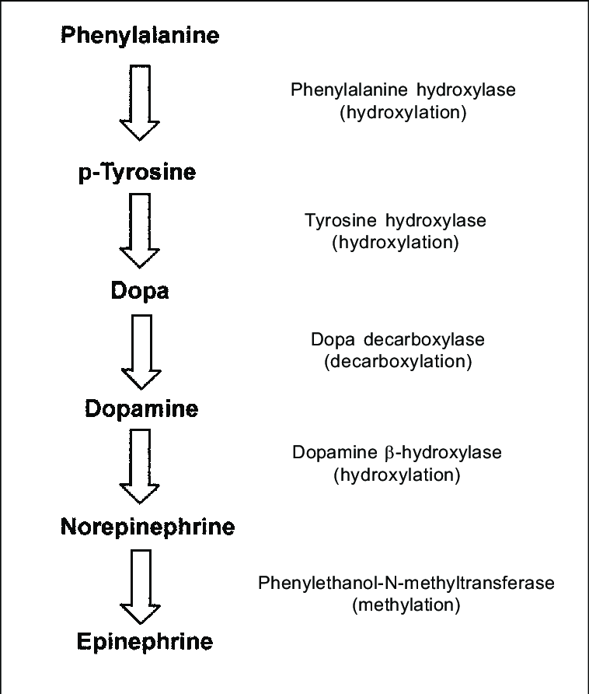
Adrenal medullary hormones-Biosynthesis
https://www.researchgate.net/figure/Catecholamine-synthesis_fig4_237385789

Slide 47
Receptors for adrenal medullary hormones
Alpha 1,&2 receptors-mediates more nor-adrenaline action
Beta 1 receptors-mediates both adrenaline and noradrenaline action equally
Beta 2 receptors -mediates more adrenaline action

Slide 48
Sympatho-adrenal medullary system
Conditions when activated
Fear,anxiety,pain,trauma,hemorrhage
fluid loss,asphyxia,hypoxia,Changes in blood pH
exposure to extreme heat or cold
Severe exercise,hypoglycemia,hypotension

Slide 49
Fight or Flight reactions
Dilates pupil-lets more light in
Increase HR and BP-Provide better perfusion of vital organs and muscles
Constricts skin blood vessels-limits bleeding
Stimulates reticular formation-Reinforce alert and arousal states
Increase Blood glucose and FFA levels-Supply more energy

Slide 50
Adrenal medullary hormones-Function
Situations with which individuals are familiar-NE secretion
Situations with which individuals are unfamiliar-Epinephrine secretion
Sympathetic nerves-NE action predominant- regulation of BP,vascular tone and blood flow
Adrenal medulla-EP predominant - Metabolism

Slide 51
Catecholamines-Functions
Metabolic effect
On carbohydrate metabolism
Increase blood glucose level
Glycogenolysis in muscle-Lactic acid formation
Inhibition of insulin secretion

Slide 52
Catecholamines-Functions
On lipid metabolism
Lipolytic (needs glucocorticoids)
On mineral metabolism
Distribution of intracellular and extracellular potassium
Calorigenic effect
Increase tissue metabolism leading to increase BMR in the presence of thyroid and glucocorticoids only-Permissive action

Slide 53
Catecholamines-Functions
On CVS
Increase heart rate
Force of contraction
Excitability
Conductivity
Vasoconstrictor
Noradrenaline-General vasoconstrictor
Adrenaline-vasodilation on skeletal muscles

Slide 54
Catecholamines-Functions
On Blood pressure
Adrenaline-Increases Systolic blood pressure
Decreases diastolic BP
Noradrenaline-Increases BP
On respiratory system
Bronchodialatation

Slide 55
Catecholamines-Functions
ON GIT
Decreases motility
Contraction of sphincters

Slide 56
Catecholamines-Systemic actions
Skeletal muscle-increase contractility and excitability
Adipose tissue-release of fatty acids
On blood-
Increase blood glucose, lactic acid
Increase RBC, Hb, plasma protein
Decrease eosinophil and lymphocyte
Coagulation time shortened

Slide 57
Catecholamines-Systemic actions
On Spleen
Contraction of spleen
On CNS
Lowers threshold of ARAS and stimulates producing alertness and arousal

Slide 58
Pheochromocytoma
Tumor of Adrenal medulla-nor-epinephrine mainly
Cardinal features
Paroxysmal Hypertension
(If adrenaline is predominant HT not prominent)
Hyperglycemia
Glycosuria
Dyspnea
Palpitation, sweating , tremor, nervousness

Slide 59
Thank you

